Slide 1
Retail Sales Analysis Presentation

Slide 2
Project analysis slide 2
Retail Sales Analysis
INTRODUCTION
Process
Insights
Summary

Slide 3
INTRODUCTION
Welcome to the Retail Sales and Customer Demographics Dataset! This synthetic dataset has been meticulously crafted to simulate a dynamic retail environment. It provides an ideal playground for those eager to sharpen their data analysis skills through exploratory data analysis (EDA). With a focus on retail sales and customer characteristics, this dataset invites you to unravel intricate patterns, draw insights, and gain a deeper understanding of customer behavior.
Dataset Overview:
This dataset is a snapshot of a fictional retail landscape, capturing essential attributes that drive retail operations and customer interactions. It includes key details such as Transaction ID, Date, Customer ID, Gender, Age, Product Category, Quantity, Price per Unit, and Total Amount. These attributes enable a multifaceted exploration of sales trends, demographic influences, and purchasing behaviors.

Slide 4
PROCESS
Data gathering
Data cleaning
Data modelling
Data analysis
Uncovering insights

Slide 5
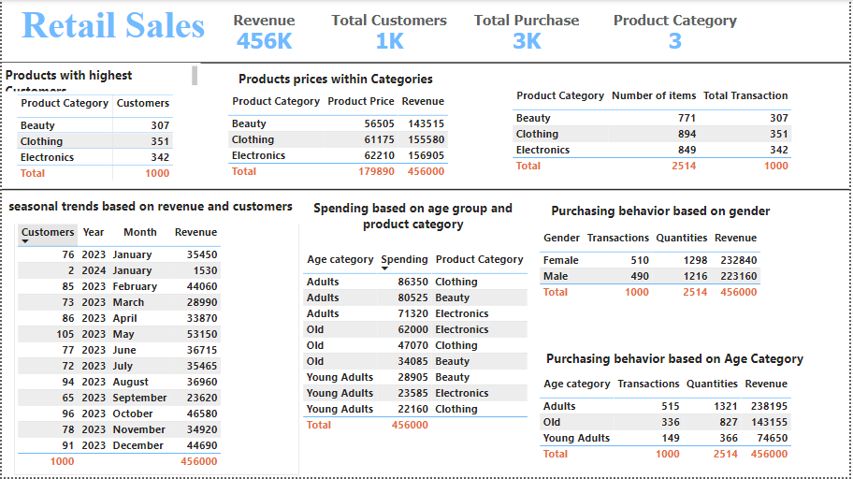
Project analysis slide 4
Data Over View
Tasks
Management Objectives
Project Objectives
Implementation Plan
Schedules
Customer Objectives
Resources

Slide 6
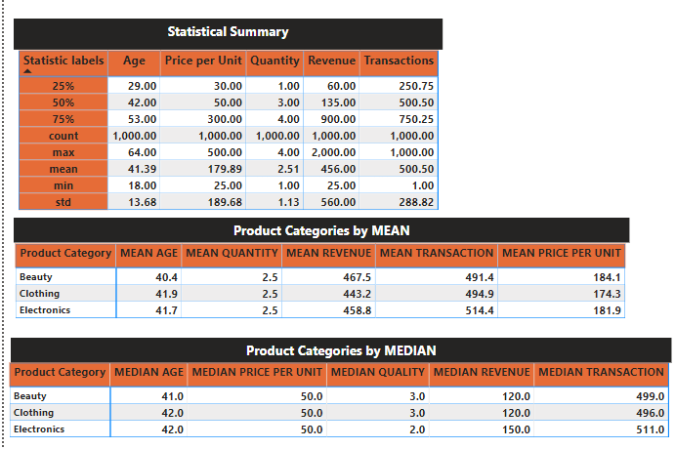

Slide 7
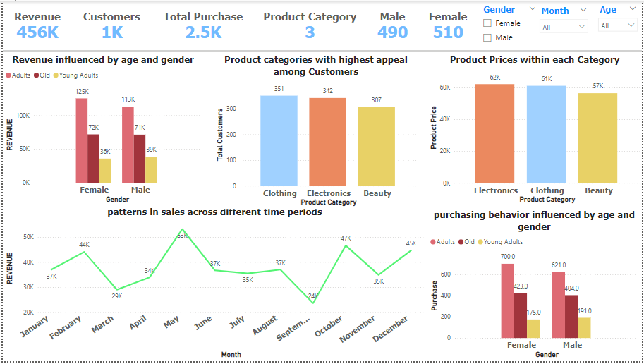

Slide 8
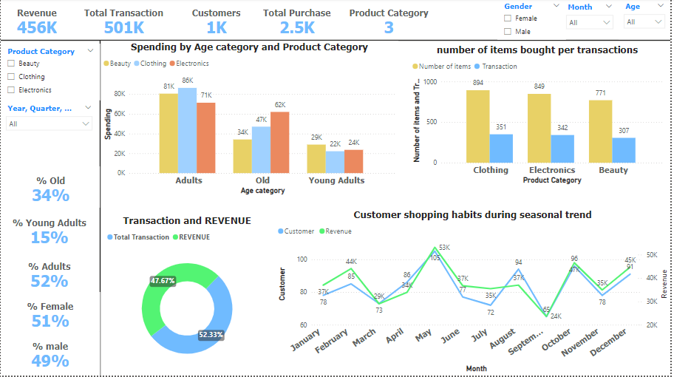

Slide 9
Project analysis slide 6
KEY METRICS
TOTAL
PURCHASE.
REVENUE
CUSTOMERS.
456K
1K
2.5K
FEMALE.
MALE.
PRODUCT
CATEGORY.
510
490
3

Slide 10
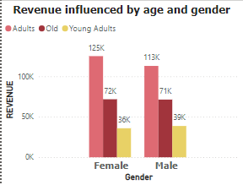
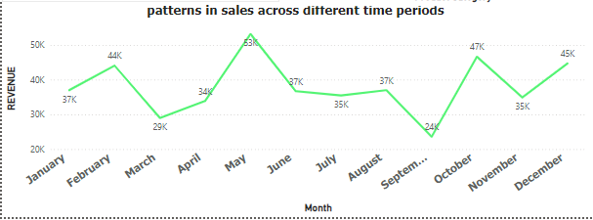
Project analysis slide 3
Insight Analysis
Revenue generated by Gender and Age
SALES ACROSS DIFFERENT TIME PERIODS
Female customers tend to having a higher revenue generated in product purchase more than the Male in all age group except for the young adults
May happens to have the highest sales across the different time periods in the year with a revenue of 53k

Slide 11
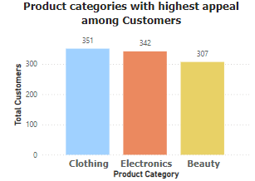
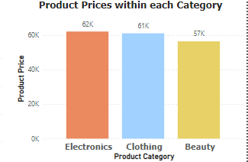
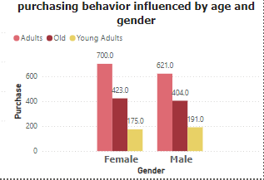
Project analysis slide 3
Insight Analysis
Product with highest appeal among customers
Purchasing behavior among gender and age
Product prices within each category
Female customers tend to having a higher purchasing habit more than the Male in all age group except for the young adults
Clothing has the most appeal among customers, it happens to be the product customers patronize more
Electronics has the highest prices in the list of products categories with a total prices of 62k

Slide 12
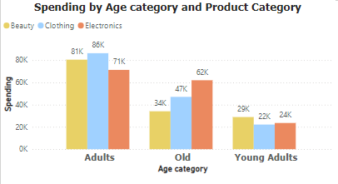
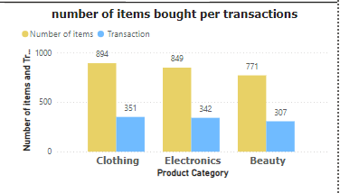
Project analysis slide 3
Insight Analysis
Spending by age and product category
Number of items bought per transactions
Adults tend to having a good spending lifestyle, and in all products, adults tend to spend more especially in clothing.
Clothing is the highest items bought and also has the highest transaction made in every purchase

Slide 13
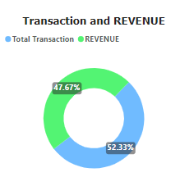
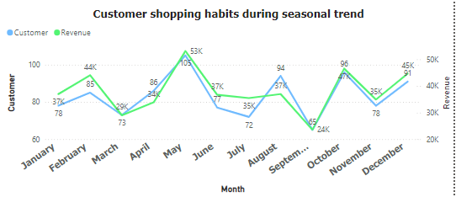
Project analysis slide 3
Insight Analysis
Transaction and Revenue
Customer shopping habits during seasonal trend
Comparison between Revenue made from the total transactions shows that we have more of transactions made with less revenue generated.
Customers shop more in may than any other period in the year

Slide 14
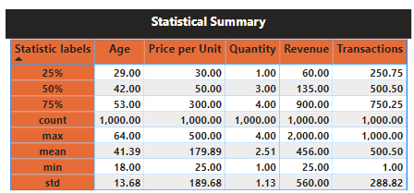
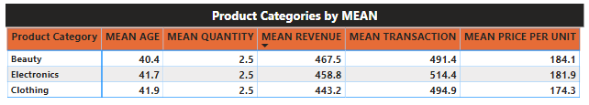
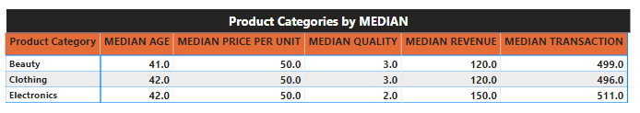
Project analysis slide 5
Project Analysis

Slide 15
Project analysis slide 10
SUMMARY
This analysis has provided key findings, insights into user preferences, products, and seasonal trends, and potential recommendations for business growth and improvement. The results obtained from this analysis highlight opportunities for increased profitability and user satisfaction.
Recommendation
The top preference for most people is clothing, as everyone needs to change their clothes every season. Therefore, it's a good investment to put more money into clothing. Electronics come next as they help make day-to-day activities easier for people.

Slide 16
Thank You

